Slide 1
CCE201: Solid State Electronic Devices
EEC223: Electronics (1)
Lecture 06 Bipolar Junction Transistors (1)
Prepared By
Dr. Eng. Sherif Hekal
Assistant Professor, CCE department

Slide 2
Introduction
IN THIS CHAPTER YOU WILL LEARN
The physical structure of the bipolar transistor and how it works.
How the voltage between two terminals of the transistor controls the current that flows through the third terminal, and the equations that describe these current-voltage relationships.
How to analyze and design circuits that contain bipolar transistors, resistors, and dc sources.
How the transistor can be used to make an amplifier.

Slide 3
Introduction
IN THIS CHAPTER YOU WILL LEARN
How to obtain linear amplification from the fundamentally nonlinear BJT.
The three basic ways for connecting a BJT to be able to construct amplifiers with different properties.
Practical circuits for bipolar-transistor amplifiers that can be constructed by using discrete components.

Slide 4
Introduction
This chapter examines a three-terminal device.
bipolar junction transistor
BJT was invented in 1948 at Bell Telephone Laboratories.
Ushered in a new era of solid-state circuits.
It was replaced by MOSFET as predominant transistor used in modern electronics.
Notes:
The bipolar transistor enjoyed nearly three decades as the device of choice in the design of both discrete and integrated circuits.
Although the MOSFET had been known very early on, it was not until the 1970s and 1980s that it became a serious competitor to the BJT. By 2009, the MOSFET was undoubtedly the most widely used electronic device, and CMOS technology the technology of choice in the design of integrated circuits. Nevertheless, the BJT remains a significant device that excels in certain applications. For instance, the reliability of BJT circuits under severe environmental conditions makes them the dominant device in certain automotive applications.

Slide 5
Introduction
Three-terminal devices are more useful than two-terminal ones, such as the diodes, because they can be used in a multitude of applications:
signal amplification
design of digital logic and memory circuits.
The basic principle is the use of the voltage between two terminals to control the current flowing in the third terminal.
In this way, a three-terminal device can be used to realize a controlled source.
Notes:
The BJT is still the preferred device in very demanding analog circuit applications, both integrated and discrete. This is especially true in very-high-frequency applications, such as radio-frequency (RF) circuits for wireless systems. A very-high-speed digital logic-circuit family based on bipolar transistors, namely, emitter-coupled logic, is still in use.
Finally, bipolar transistors can be combined with MOSFETs to create innovative circuits that take advantage of the high-input-impedance and low-power operation of MOSFETs and the very-high-frequency operation and high-current-driving capability of bipolar transistors. The resulting technology is known as BiCMOS.

Slide 6
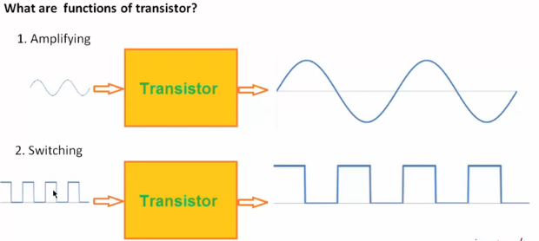
Introduction

Slide 7
6.1. Device Structure and Physical Operation
Figure 6.1 shows simplified structure of BJT.
Consists of three semiconductor regions:
emitter region (n-type)
base region (p-type)
collector region (n-type)
Type described above is referred to as npn.
However, pnp types do exist.

Slide 8
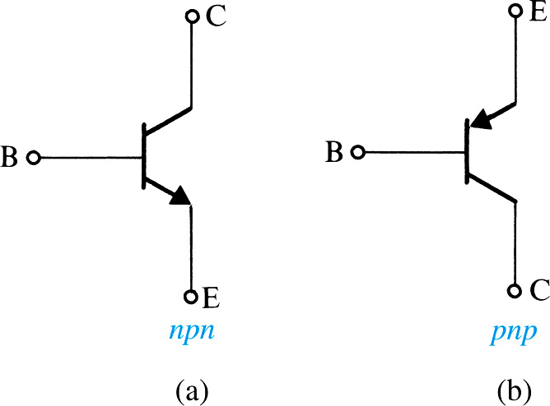
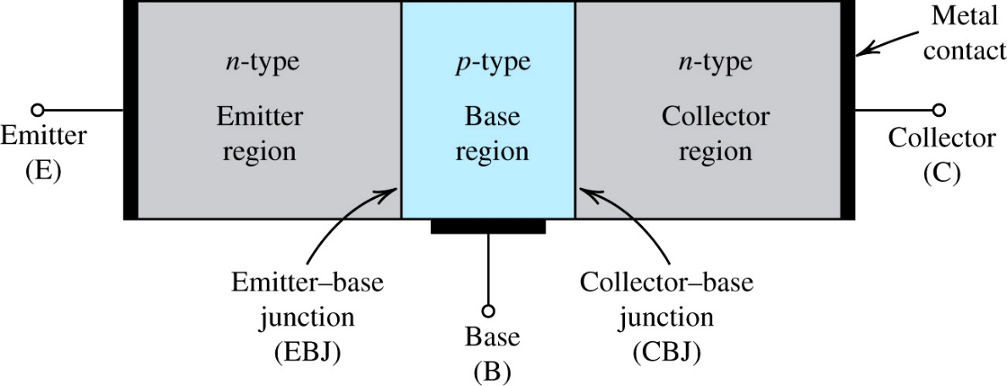
6.1. Device Structure and Physical Operation
Figure 6.1: A simplified structure of the npn transistor.
Notes:
The transistor consists of two pn junctions, the emitter–base junction (EBJ) and the collector–base junction (CBJ).
Depending on the bias condition (forward or reverse) of each of these junctions, different modes of operation of the BJT are obtained, as shown in Table 6.1

Slide 9
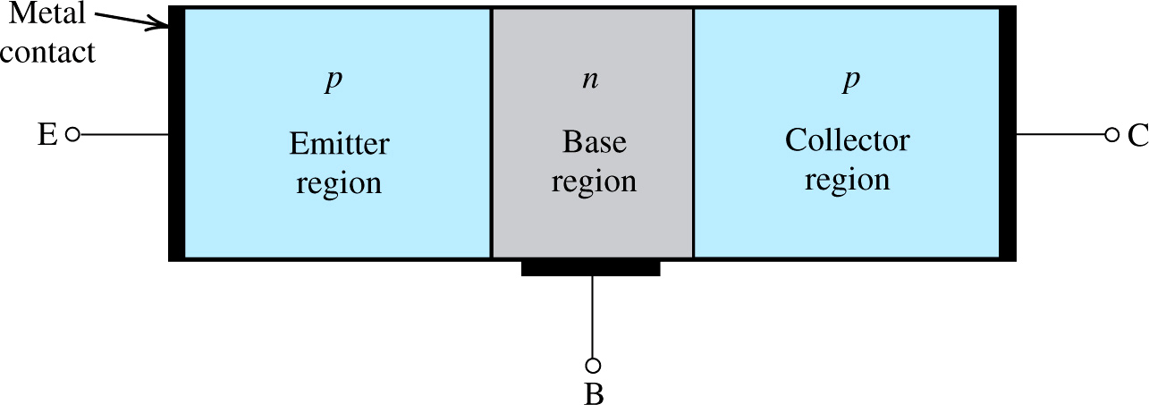
6.1. Device Structure and Physical Operation
Figure 6.2: A simplified structure of the pnp transistor.
Notes:
Note that this is normally implemented by doping regions on the surface of a silicon chip

Slide 10
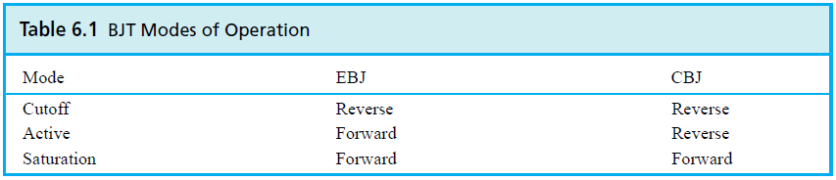
6.1.1. Simplified Structure and Modes of Operation
Transistor consists of two pn-junctions:
emitter-base junction (EBJ)
collector-base junction (CBJ)
Operating mode depends on biasing.
active mode – used for amplification
cutoff and saturation modes – used for switching.
Notes:
It is two diodes back to back with a narrow base region in common.
As we will see shortly, charge carriers of both polarities—that is, electrons and holes— participate in the current-conduction process in a bipolar transistor, which is the reason for the name bipolar.

Slide 11
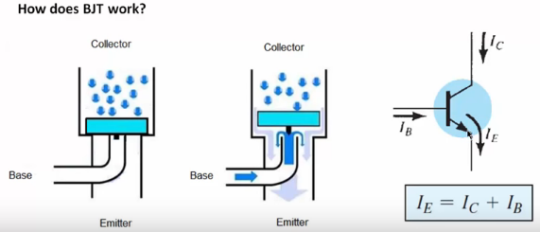
6.1. Device Structure and Physical Operation

Slide 12
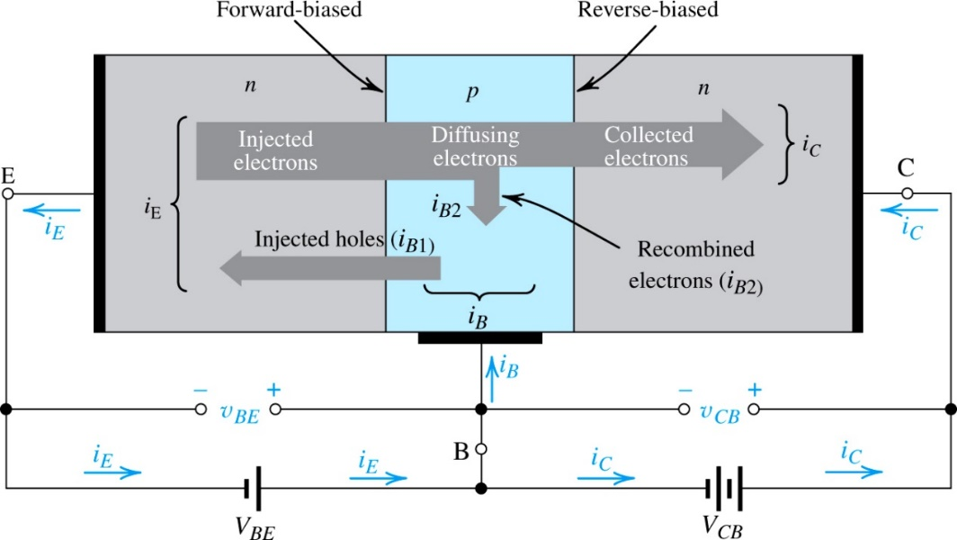
6.1.2. Operation of the npn-Transistor in the Active Mode
Active mode is the “most important.”
Two external voltage sources are required for biasing to achieve it.
Refer to Figure 6.3.
Figure 6.3: Current flow in an npn transistor biased to operate in the active mode. (Reverse current components due to drift of thermally generated minority carriers are not shown.)
Notes:
VBE causes the p-type base to be higher in potential than the n-type emitter, thus forward-biasing the emitter–base junction. The collector–base voltage VCB causes the n-type collector to be at a higher potential than the p-type base, thus reverse-biasing the collector–base junction.

Slide 13
The Collector Current
It is observed that most diffusing electrons will reach boundary of collector-base depletion region.
Because collector is more positive than base, these electrons are swept into collector.
collector current (i_{C}) is approximately equal to I_{n}.
i_{C} = I_{n}

Slide 14
The Collector Current
Magnitude of i_{C} is independent of v_{CB}.
As long as collector is positive, with respect to base.
saturation current (I_{S}) – is inversely proportional to W and directly proportional to area of EBJ.
Typically between 10⁻¹² and 10⁻¹⁸A
Also referred to as scale current.
Notes:
Because IS is proportional to ni^2, it is a strong function of temperature, approximately doubling for every 5°C rise in temperature. (For the dependence of ni^2 on temperature, refer to Eq. 3.37.)
Since IS is directly proportional to the junction area (i.e., the device size), it will also be referred to as the scale current. Two transistors that are identical except that one has an EBJ area, say, twice that of the other will have saturation currents with that same ratio (i.e., 2). Thus for the same value of vBE the larger device will have a collector current twice that in the smaller device. This concept is frequently employed in integrated-circuit design.

Slide 15
The Base Current

Slide 16
The Base Current
common-emitter current gain (β.) – is influenced by two factors:
width of base region (W)
relative doping of base emitter regions (N_{A}/N_{D})
High Value of β
thin base (small W in nano-meters)
lightly doped base / heavily doped emitter (small N_{A}/N_{D})
β is in the range 50 to 200

Slide 17
The Emitter Current
All current which enters transistor must leave.
i_{E} = i_{C} + i_{B}
Equations (6.7) through (6.13) expand upon this idea.
Notes:
Since the current that enters a transistor must leave it, it can be seen from Fig. 6.3 that the emitter current iE is equal to the sum of the collector current iC and the ..Qb~43FCase current iB; that is,

Slide 18
Recapitulation and Equivalent-Circuit Models
Next slides present first-order BJT model.
Assumes npn transistor in active mode.
Basic relationship is collector current (i_{C}) is related exponentially to forward-bias voltage (v_{BE}).
It remains independent of v_{CB} as long as this junction remains reverse biased.
v_{CB} > 0
Thus in the active mode the collector terminal behaves as an ideal constant-current source where the value of the current is determined by v_{BE}.
Notes:
Basically, the forward-bias voltage vBE causes an exponentially related current iC to flow in the collector terminal. The collector current iC is independent of the value of the collector voltage as long as the collector–base junction remains
reverse biased; that is, vCB ≥ 0. Thus in the active mode the collector terminal behaves as an ideal constant-current source where the value of the current is determined by vBE.

Slide 19
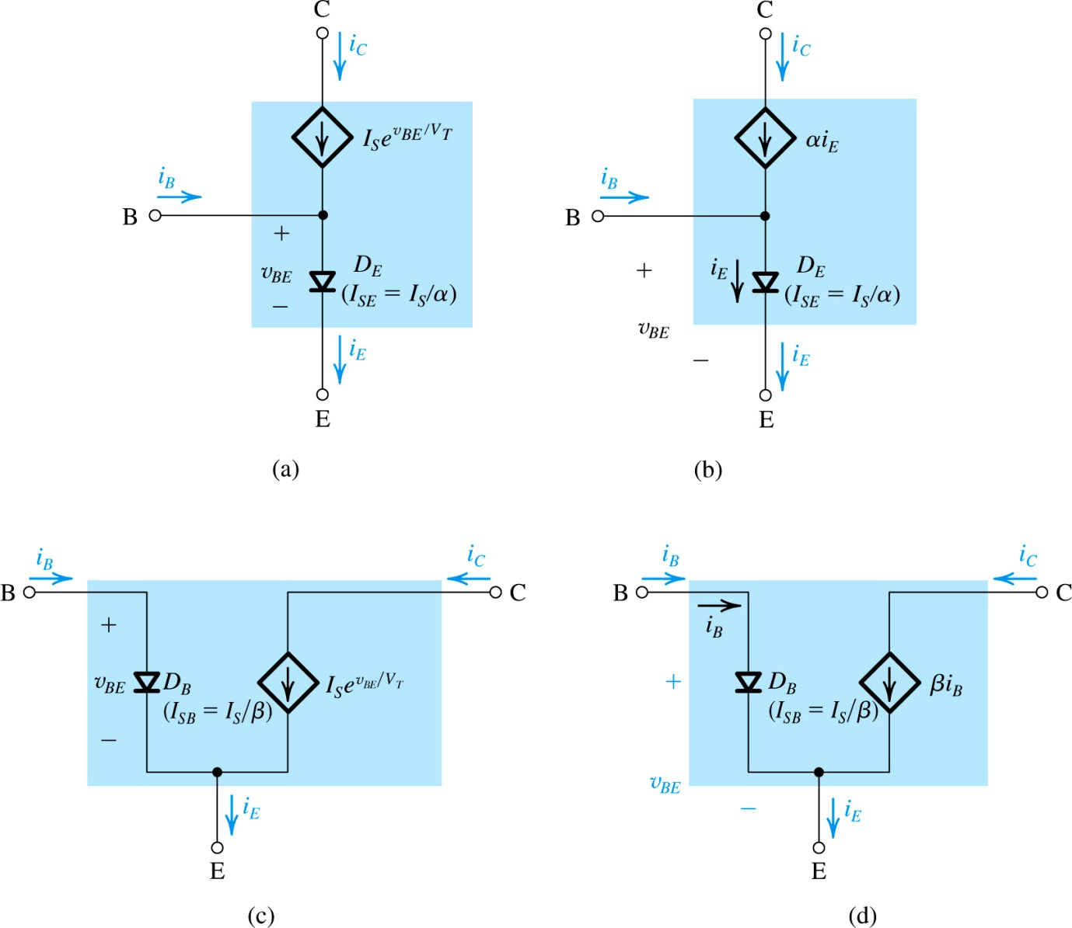
Thus α is called the common-base current gain.
Thus β is called the common-emitter current gain.
Figure 6.4: Large-signal equivalent-circuit models of the npn BJT operating in the active mode (a), (b) common base configuration. (c), (d) common emitter configuration.
Notes:
From model (b) we observe that if the transistor is used as a two-port network with the input port between E and B and the output port between C and B (i.e., with B as a common terminal), then the current gain observed is equal to α. Thus α is called the common-base current gain.
From model (d) we observe that if the transistor is used as a two-port network with the input port between B and E and the output port between C and E (i.e., with E as the common terminal), then the current gain observed is equal to β. Thus β is called the common-emitter current gain.
Finally, we note that the models in Fig. 6.5 apply for any positive value of vBE. That is, unlike the models we will be discussing in Section 6.5, here there is no limitation on the size of vBE, and thus these models are referred to as large-signal models.

Slide 20
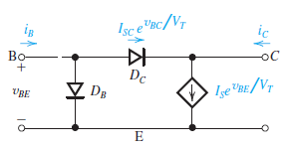
6.1.4. Operation in Saturation Mode
For BJT to operate in active mode, CBJ must be reverse biased.
However, for small values of forward-bias, a pn-junction does not operate effectively.
As such, active mode operation of npn-transistor may be maintained for v_{CB} down to approximately -0.4V.
Only after this point will “diode” begin to really conduct.
Figure 6.5 Modeling the operation of an npn transistor in saturation by augmenting the model of Fig. 6.5(c) with a forward conducting diode DC. Note that the current through DC increases i_{B} and reduces i_{C}.

Slide 21
6.1.4. Operation in Saturation Mode
Notes:
Because i_{C}/i_{B} of a saturated transistor can be set to any desired value lower than β by adjusting v_{CB} this ratio is known as forced β and denoted β_{forced},

Slide 22
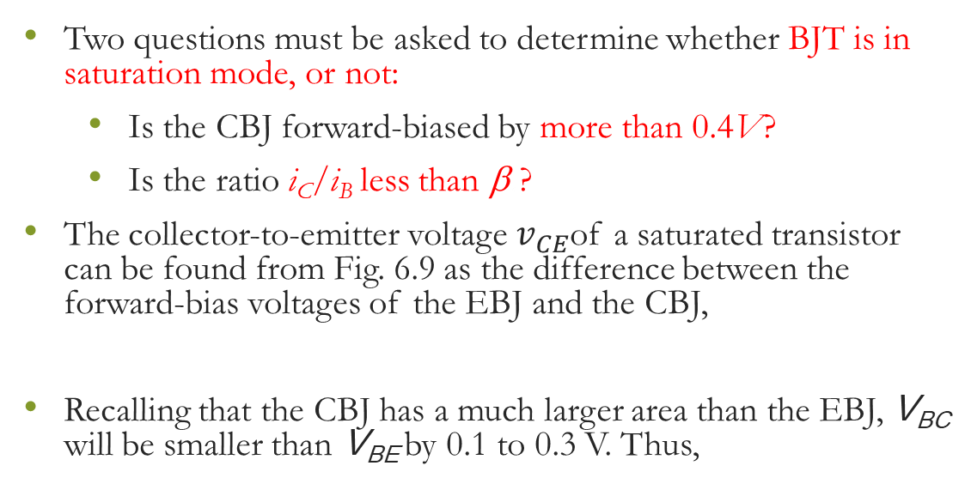

6.1.4. Operation in Saturation Mode
Two questions must be asked to determine whether BJT is in saturation mode, or not:
Is the CBJ forward-biased by more than 0.4V?
Is the ratio i_{C}/i_{B} less than β.?
The collector-to-emitter voltage $v_{CE}$of a saturated transistor can be found from Fig. 6.9 as the difference between the forward-bias voltages of the EBJ and the CBJ,
Recalling that the CBJ has a much larger area than the EBJ, V_{BC} will be smaller than V_{BE} by 0.1 to 0.3 V. Thus,
V_{CEsat} = V_{BE} – V_{BC}
$$V_{CEsat}≃0.1 to 0.3 V$$
Notes:
Emitter is a heavily doped region of the BJT transistor which provides majority carriers into the base region.
Base region is a thin, lightly doped region and is sandwiched between emitter and collector.
Collector region is moderately doped.

Slide 23
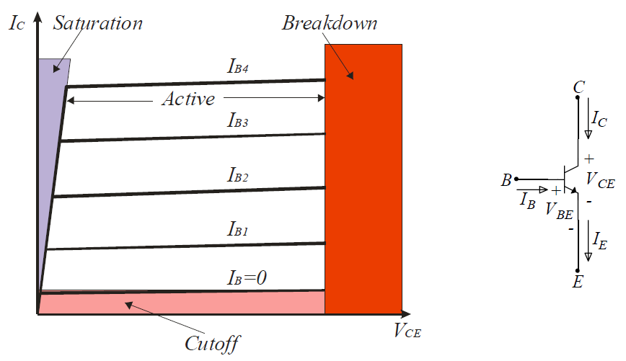
BJT regions of operation

Slide 24
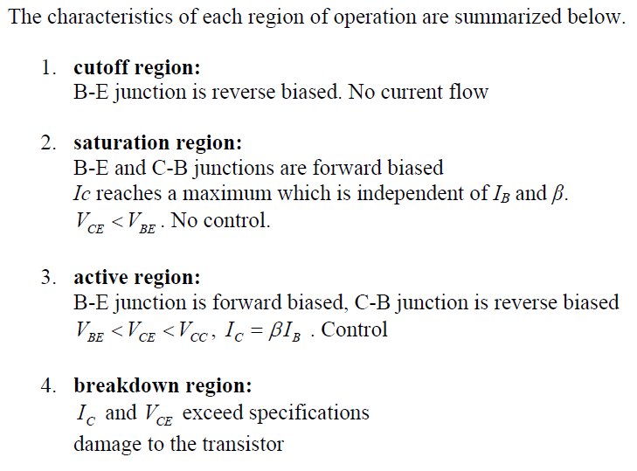

Slide 25
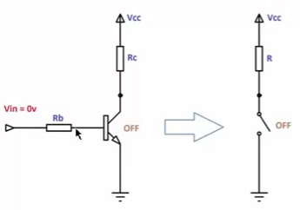
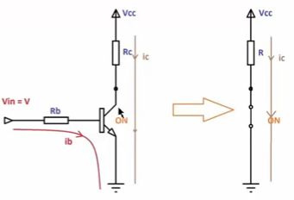
BJT applications
NPN BJT switch circuit

Slide 26
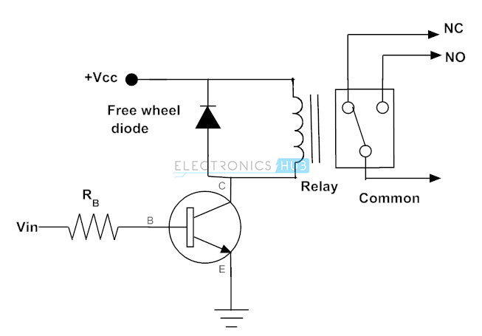
BJT applications
NPN BJT switch circuit
Use relay to separate the control circuit from the high current/voltage electrical circuit
Notes:
Consider the below circuit to know the operation of a transistor to energize the relay coil. The input applied at the base causes to drive the transistor into saturation region, which further results the circuit becomes short circuit. So the relay coil gets energized and relay contacts get operated.
In inductive loads, particularly switching of motors and inductors, sudden removal of power can keep a high potential across the coil. This high voltage can cause considerable damage to the rest circuit. Therefore, we have to use the diode in parallel with inductive load to protect the circuit from induced voltages of the inductive load.

Slide 27
BJT applications
Transistor to Drive the Motor
A transistor can also used to drive and regulate the speed of the DC motor in a unidirectional way by switching the transistor in regular intervals of time.
the DC motor is also an inductive load so we have to place a freewheeling diode across it to protect the circuit.
By switching the transistor in cutoff and saturation regions, we can turn ON and OFF the motor repeatedly.
It is also possible to regulate the speed of the motor from standstill to full speed by switching the transistor at variable frequencies. We can get the switching frequency from control device or IC like microcontroller.

Slide 28
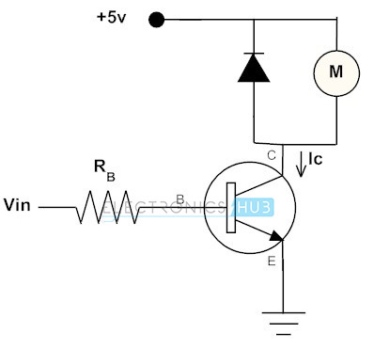
BJT applications
Control the speed of motor using Pulse Width Modulation
The duty cycle of input digital signal controls the DC level applied to the motor

Slide 29
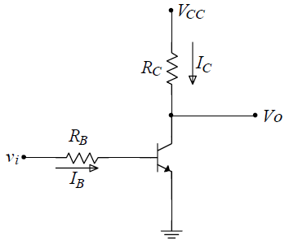
BJT applications
Vcc
Vcc
0 V
0 V
Basic BJT inverter circuit

Slide 30
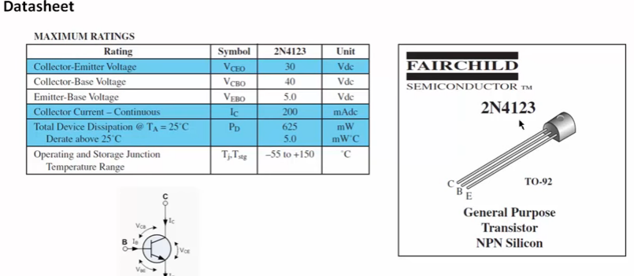

BJT Specs
P_{D}=I_{C} x V_{CE}

Slide 31
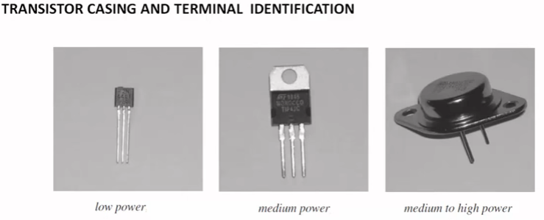
BJT Specs
Why holes
To fix heat sink for cooling

Slide 32
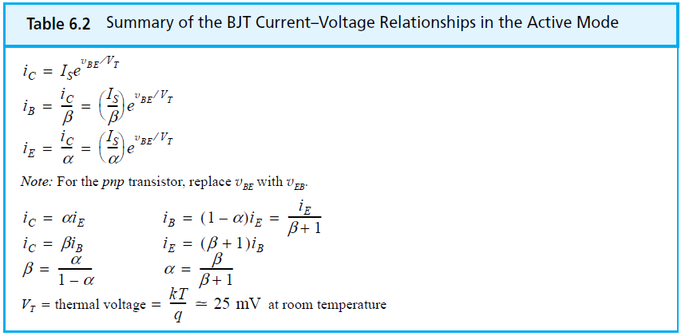
6.2.1. Circuit Symbols and Conventions
Notes:
Worth another sticky

Slide 33
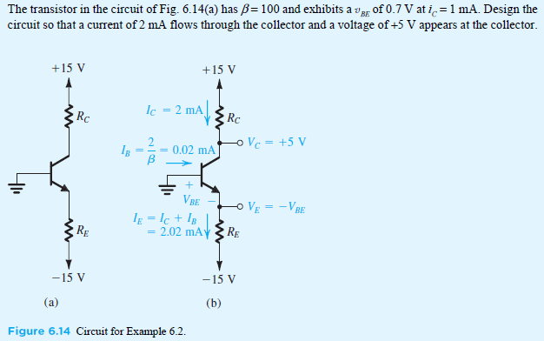
EXAMPLE 6.1

Slide 34
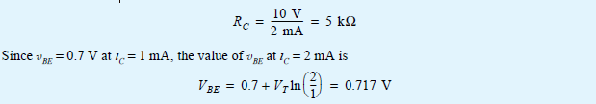
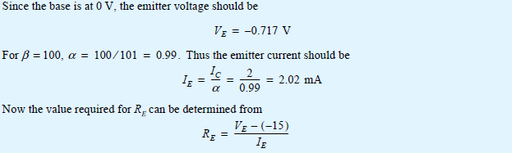

EXAMPLE 6.1 - Sol
since we are required to design for V_{C} = +5 V, the CBJ will be reverse biased and the BJT will be operating in the active mode. To obtain a voltage V_{C} = +5 V, the voltage drop across R_{C} must be 15 – 5 = 10 V.
since I_{C} = 2 mA, the value of R_{C} should be selected according to

Slide 35
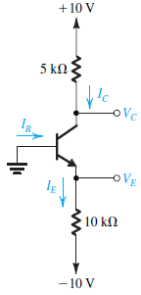
EXAMPLE 6.2
In the circuit shown in the figure, the voltage at the emitter was measured and found to be –0.7 V. If β = 50, find I_{E}, I_{B}, I_{C}, and V_{C}.
Ans. 0.93 mA; 18.2 μA; 0.91 mA; +5.45 V

Slide 36
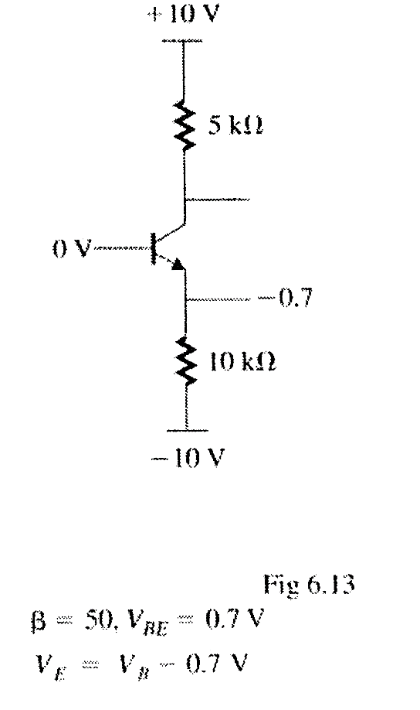
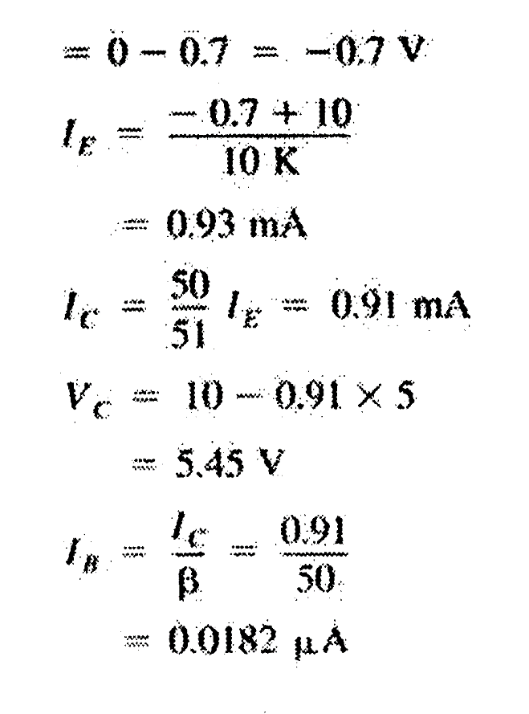
EXERCISE 6.2 - Sol

Slide 37
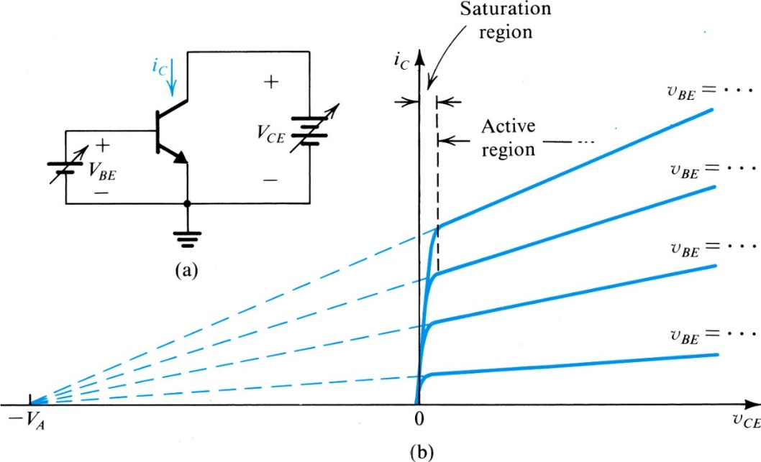
6.2.3. Dependence of i_{C} on Collector Voltage – The Early Effect
When operated in active region, practical BJT’s show some dependence of collector current on collector voltage.
As such, i_{C}-v_{CB} characteristic is not “straight”.
Figure 6.6 (a) Conceptual circuit for measuring the iC–vCE characteristics of the BJT. (b) The iC–vCE characteristics of a practical BJT.
Notes:
The BJT is a current controlled current source.
We observe that the characteristic curves, though still straight lines, have finite slope. In fact, when extrapolated, the
characteristic lines meet at a point on the negative vCE axis, at vCE = –VA. The voltage VA, a positive number, is a parameter for the particular BJT, with typical values in the range of 10 V to 100 V. It is called the Early voltage, after J. M. Early, the engineering scientist who first studied this phenomenon.
the Early voltage is sufficiently large compared with the applied collector-to-emitter voltage to permit the following approximation.

Slide 38



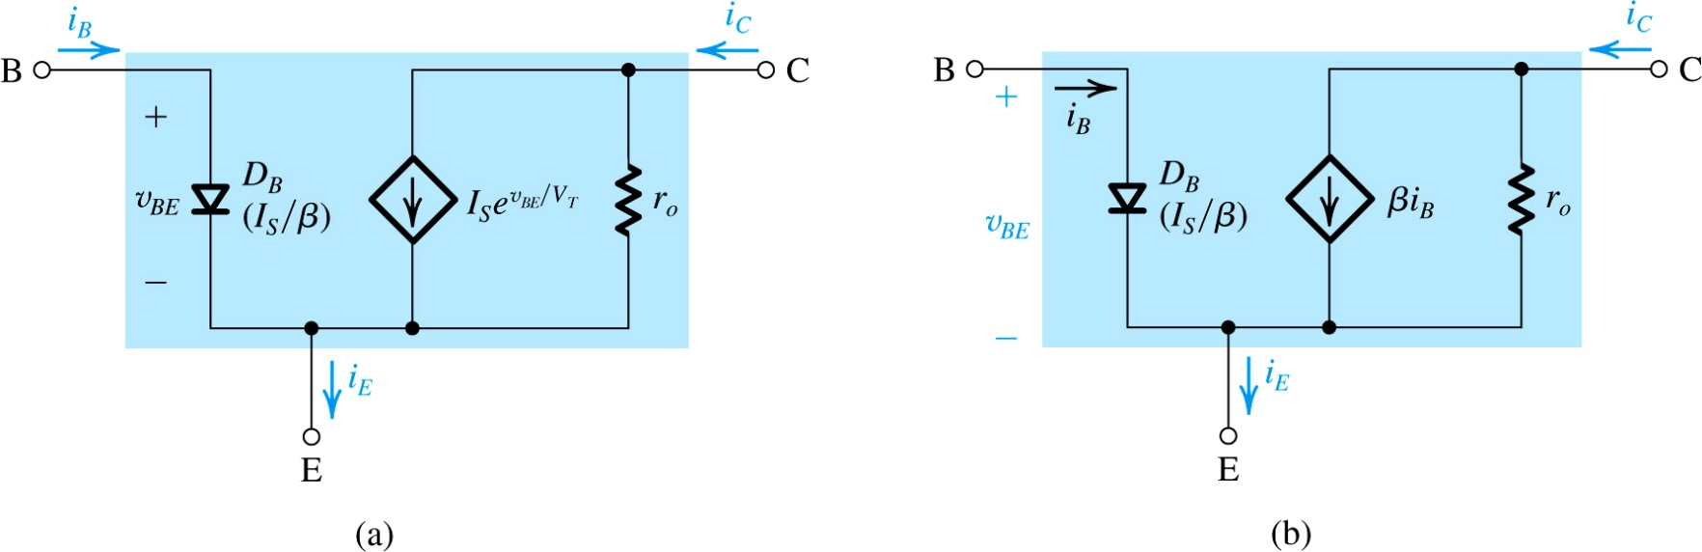
6.2.3. Dependence of i_{C} on Collector Voltage – The Early Effect
Figure 6.7: Large-signal equivalent-circuit models of an npn BJT operating in the active mode in the common-emitter configuration with the output resistance r_{o} included.
Notes:
This is a useful model of a BJT
At a given value of vBE, increasing vCE increases the reverse-bias voltage on the collector– base junction, and thus increases the width of the depletion region of this junction (refer to Fig. 6.3). This in turn results in a decrease in the effective base width W. Recalling that IS is inversely proportional to W (Eq. 6.4), we see that IS will increase and that iC increases proportionally. This is the Early effect.

Slide 39
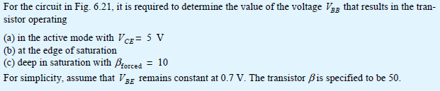
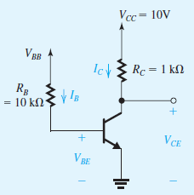
Example 6.3

Slide 40
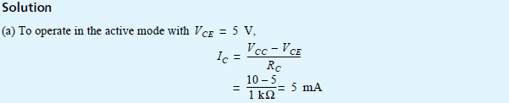
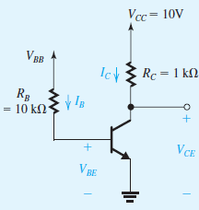

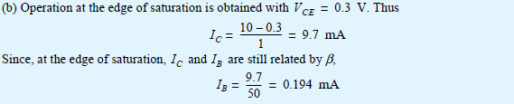
Example 6.3 - Sol

Slide 41
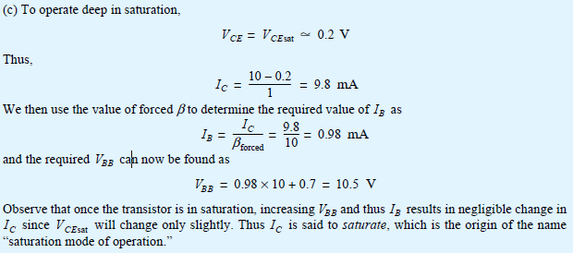
Example 6.3 - Sol

Slide 42

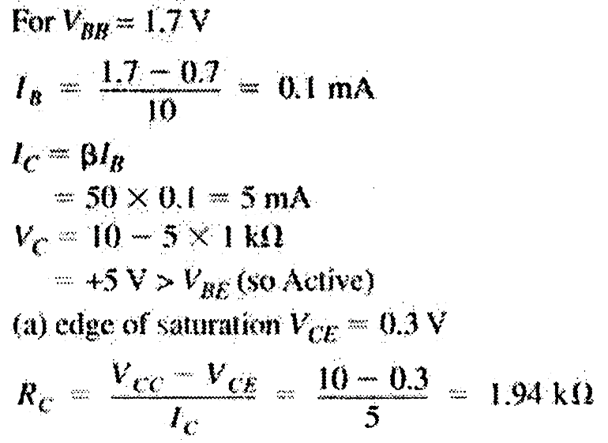
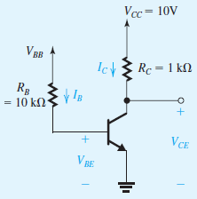
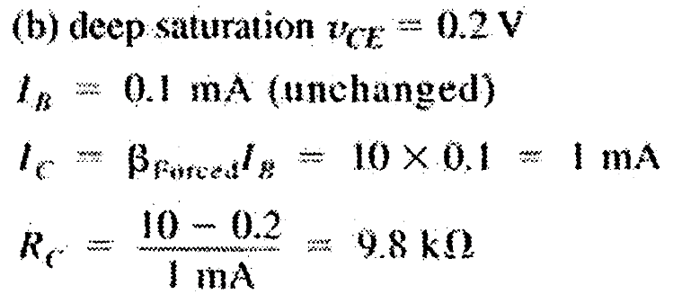
EXAMPLE 6.4
6.8
Figure 6.8

Slide 43
Summary
Depending on the bias condition on its two junctions, the BJT can operate in one of three possible modes:
cut-off (both junctions reverse biased)
active (the EBJ forward-biased and CBJ reversed)
saturation (both junctions forward biased)
For amplifier applications, the BJT is operated in the active mode. Switching applications make use of the cutoff and saturation modes.
A BJT operating in the active mode provides a collector current i_{C} = I_{S}exp{v_{BE}/V_{T}}. The base current i_{B} = i_{C}/β, and emitter current i_{E} = i_{C} + i_{B}.

Slide 44
Summary
To ensure operation in the active mode, the collector voltage of an npn-transistor must be kept higher than approximately 0.4V below the base voltage. For a pnp-transistor, the collector voltage must be lower than approximately 0.4V above the base voltage. Otherwise, the CBJ becomes forward-biased and the transistor will enter saturation.
At a constant collector current, the magnitude of the base emitter voltage decreases by about 2mV for every 1^{O}C rise in temperature.
The BJT will be at the edge of saturation when |v_{CE}| is reduced to about 0.3V.

Slide 45
Summary
In the active mode, i_{C} shows a slight dependence on v_{CE}. This phenomenon, known as the Early Effect, is modeled by ascribing a finite output resistance to the BJT: r_{o} = |V_{A}|/I’_{C} where V_{A} is the Early Voltage and I’_{C} is the dc collector current without the Early Effect taken into account.
The dc analysis of transistor circuits is generally simplified by assuming |V_{BE}| = 0.7V.

Slide 46
BJT Circuits at DC
in analyzing a circuit the first question that one must answer is: In which mode is the transistor operating?
quick check of the terminal voltages.
Assume that the transistor is operating in the active mode, and determine the various voltages and currents that correspond.
Then check for consistency of the results with the assumption of active-mode operation (v_{CB}> -0.4 volt);
If the answer is no, assume saturation-mode then test
compute the ratio I_{C} ⁄ I_{B} and to verify that it is lower than the transistor β (i.e., β_{forced} < β ).

Slide 47
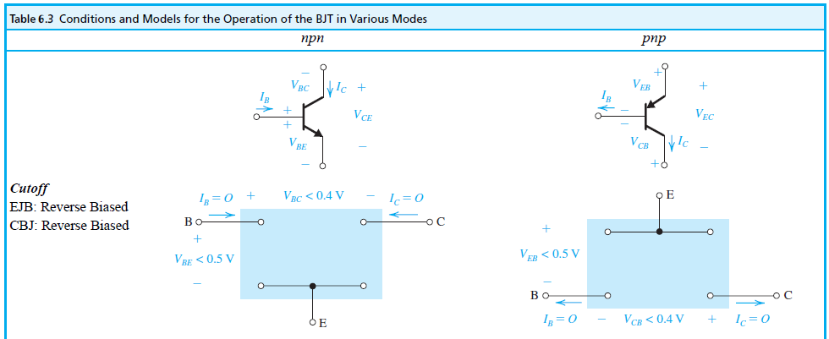
BJT Circuits at DC

Slide 48
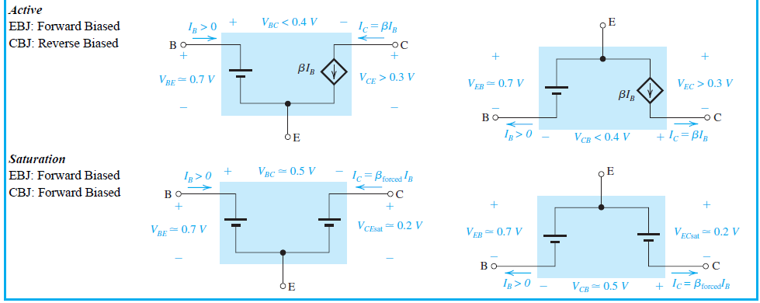
BJT Circuits at DC
Notes:
We are now ready to consider the analysis of BJT circuits to which only dc voltages are applied. In the following examples we will use the simple model in which V_{BE} of a conducting transistor is 0.7 V and of V_{CE} a saturated transistor is 0.2 V,

Slide 49
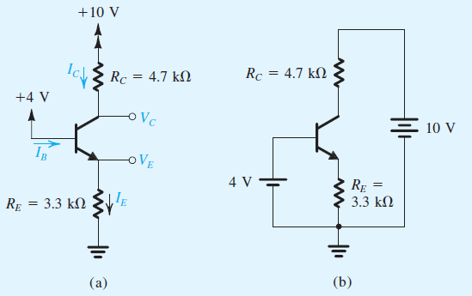
Example 6.5
Consider the circuit shown in Fig. 6.9(a), which is redrawn in Fig. 6.9(b) to remind the reader of the convention employed throughout this book for indicating connections to dc sources. We wish to analyze this circuit to determine all node voltages and branch currents. We will assume that β is specified to be 100.
Figure 6.9

Slide 50
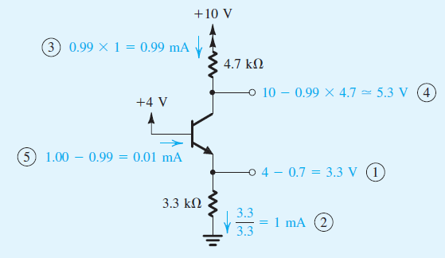
Example 6.5 – Sol.

Slide 51
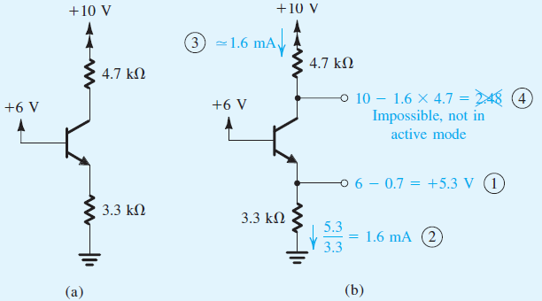
Example 6.6
We wish to analyze the circuit of Fig. 6.10 to determine the voltages at all nodes and the currents through all branches. Note that this circuit is identical to that of Fig. 1 except that the voltage at the base is now +6 V. Assume that the transistor β is specified to be at least 50.
Figure 6.10 Analysis of the circuit for Example 6.7.

Slide 52
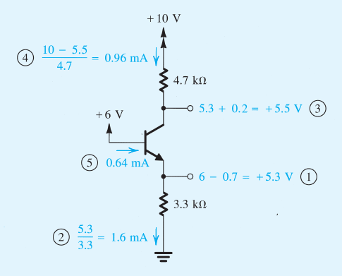
Example 6.6 – Sol.
Active mode assumption is not correct because V_{C} < V_{B}

Slide 53
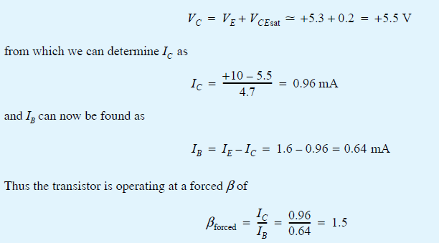
Example 6.6 – Sol.
Since β_{forced} is less than the minimum specified value of β, the transistor is indeed saturated. We should emphasize here that in testing for saturation the minimum value of β should be used. By the same token, if we are designing a circuit in which a transistor is to be saturated, the design should be based on the minimum specified β.

Slide 54
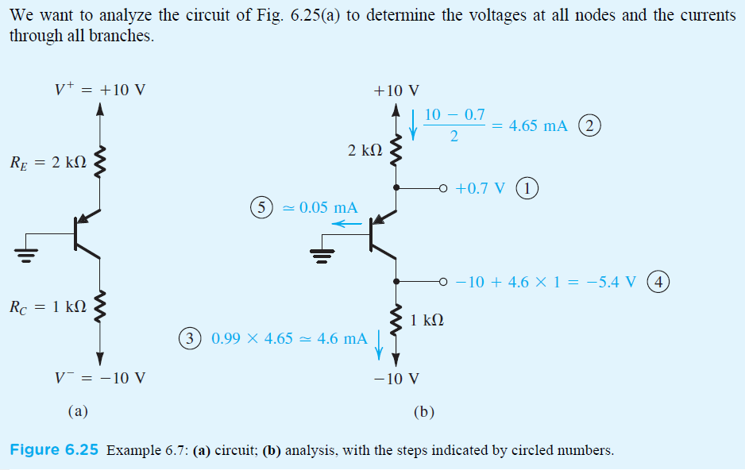
Example 6.7
Fig. 6.11 (a) to
Figure 6.11

Slide 55
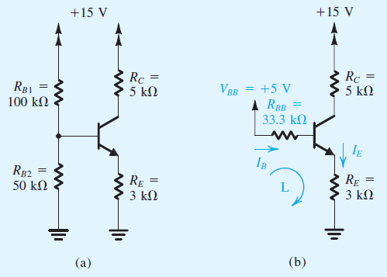
Example 6.8
We want to analyze the circuit, shown in the figure below, to determine the voltages at all nodes and the currents through all branches. Assume β = 100.
Figure 6.12

Slide 56
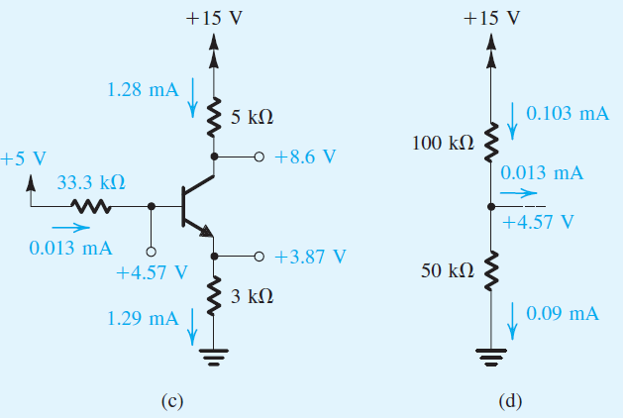
Example 6.8
Figure 6.12

Slide 57
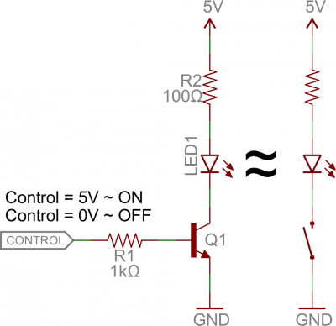
Applications
Transistor Switch

Slide 58
Applications
An H-bridge is a transistor-based circuit capable of driving motors both clockwise and counter-clockwise.
H-Bridge

Slide 59
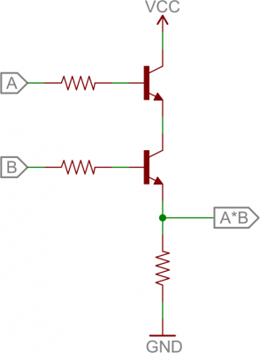
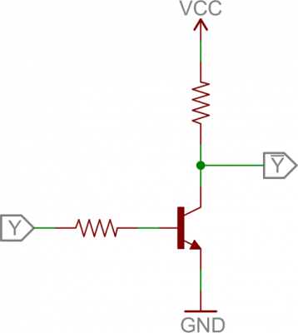

Applications
Digital Logic
Not Gate
OR Gate
AND Gate

Slide 60



Design Examples
To saturate the transistor with the lowest β, we need to provide a base current at least
Notes:
Overdrive factor to ensure deep saturation

Slide 61

Design Examples

Slide 62




Design Examples
LED
c

